Slide 1


DEPARTMENT OF ARTIFICIAL INTELLIGENCE AND DATA SCIENCE MEPCO SCHLENK ENGINEERING COLLEGE
DATA EXPLORATION AND VISUALIZATION
23AD353 -
MINI PROJECT-1
by
k.Harsitha sree – 23bad071
J.Jeevitha princy – 23bad072
N.Karthigaipriya – 23bad073

Slide 2
CONTENTS
Data Exploration – About the dataset
Data Processing
Data Visualization
Data Cleaning and Post Visualization
Advanced Visualization
Data Transformation
Visualization with R and Power BI
Conclusion

Slide 3
MODULE – 1 Sample Dataset Description
A ) Heart Disease Dataset
Description: Dataset to predict the presence of heart disease in patients based on various health indicators.
Size: 303 rows, 16 columns
Features: 13 (7 categorical, 6 numerical)
Classes: Presence of heart disease (values 1, 2, 3, 4) vs. absence (value 0)
Missing Values: Contains missing values (0.2%)

Slide 4
B ) Steel Industry Dataset
Description: Dataset from a smart small-scale steel industry in South Korea, focusing on electricity consumption.
Size: 35,040 rows, 11 columns
Features: 9 (3 categorical, 7 numerical)
Classes: N/A (Regression)
Missing Values: No missing values

Slide 5
C ) Lenses Dataset
Description: Database for fitting contact lenses based on certain eye and vision attributes.
Size: 24 rows, 4 columns
Features: 3 (all categorical)
Classes: Types of lenses or no lenses
Missing Values: Contains missing values

Slide 6
D ) Flag Dataset
Description: Data file containing details of various nations and their flags, useful for various classification tasks.
Size: 194 rows, 30 columns
Features: 30 (4 categorical, 26 numerical)
Classes: Various attributes like religion, landmass, etc.
Missing Values: Not specified

Slide 7
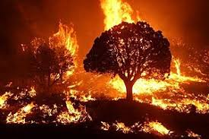
Dataset Description

Slide 8
Forest Fire
Forest Fire comprises various attributes related to forest fires, collected to study and predict the behavior of such incidents
Includes a coordinates, environmental factors, and fire-related indices with 517 instances and 13 features
11 numerical and 2 categorical
Captures both categorical and numerical data, facilitating a analysis of the factors that contribute to forest fires.
Target Variable : Area

Slide 9
Key Features :
Categorical Features :
Month: The month of the year when the fire occurred (e.g., January, February).
Day: The day of the week when the fire occurred (e.g., Monday, Tuesday).
Numerical Features :
X-axis: Spatial coordinate indicating the horizontal position within the region.
Y-axis: Spatial coordinate indicating the vertical position within the region.
FFMC: Fine Fuel Moisture Code, an index representing the moisture content of
fine fuels (grass, leaves) which affects fire ignition.
DMC: Duff Moisture Code, indicating the moisture content of the duff layer, important for fire smoldering.
DC: Drought Code, representing the moisture content in deep soil layers, impacting fire sustainability.
ISI: Initial Spread Index, which predicts the speed at which a fire spreads.
Temperature: Ambient temperature in degrees Celsius.
RH: Relative Humidity percentage.
Wind: Wind speed in kilometers per hour.
Rain: Rainfall amount in millimeters.
Area: The burned area of the forest fire in hectares.

Slide 10
Purpose:
Real-World Significance :
Addresses an important environmental issue.
Helps in understanding and managing forest fires.
Predictive Modeling :
Ideal for developing models to predict forest fire behavior.
Learning Opportunity :
Excellent for practicing data visualization and exploration techniques.
Provides hands-on experience with real-world data.
Geographical Analysis :
Allows for the study of fire patterns in different locations.
Useful for identifying high-risk areas.
Decision Support :
Supports strategies for fire prevention and control.

Slide 11
Module-2 Data Processing

Slide 12
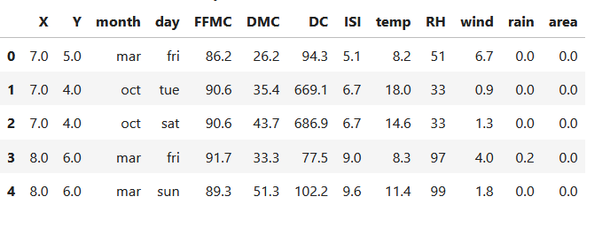
Numpy
Display the first 5 rows
display(df.head())
Checking for missing Values:
Print(df.isnull().sum())
Adding a new column:
df['temp_F'] = (df['temp'] * 9/5) + 32

Slide 13

Handling Missing Values
Numerical values
Categorical Values

Slide 14
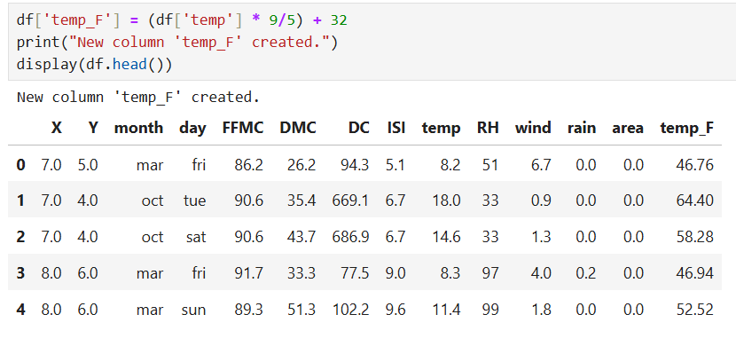
Adding new columns
Converting Temperature to Fahrenheit

Slide 15
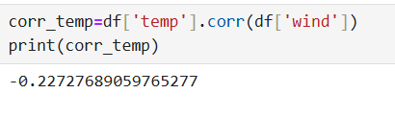
Pandas
Using group by function:
grp_data=df.groupby(‘month’).agg({‘temp’:’mean’,’rain’:’sum’})
Find correlation:
corr_temp=df[‘temp’].corr(df[‘wind’])

Slide 16
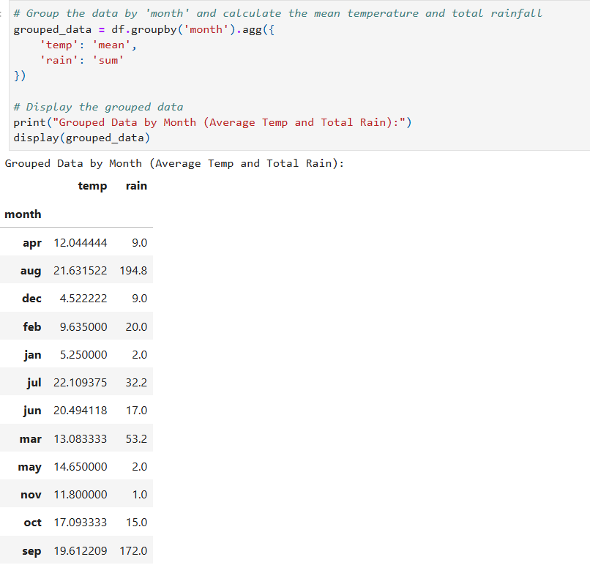
Aggregating Weather Data by Month
The aggregation function is a powerful tool used in data analysis to summarize or perform calculations on grouped data.

Slide 17
Module - 3
Data Visualization using
Matplotlib
Seaborn
Autoviz

Slide 18
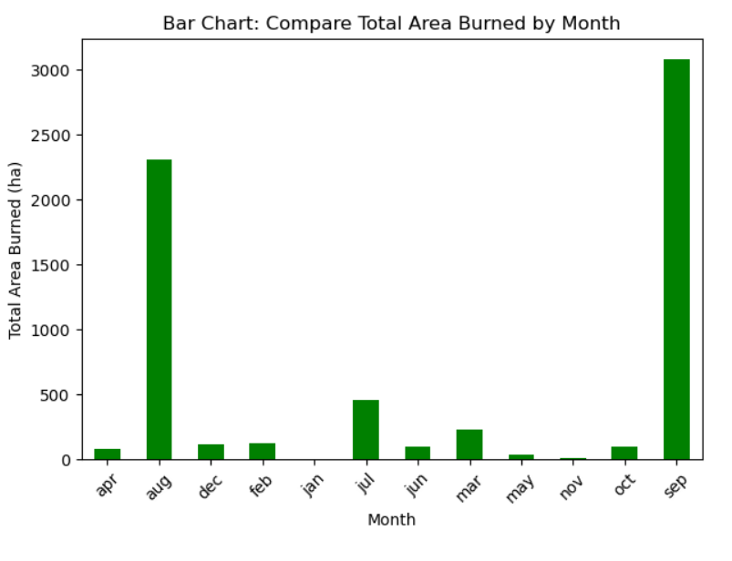
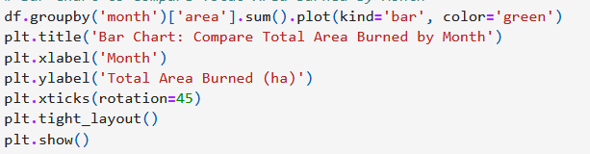
Bar Chart
MATPLOTLIB

Slide 19
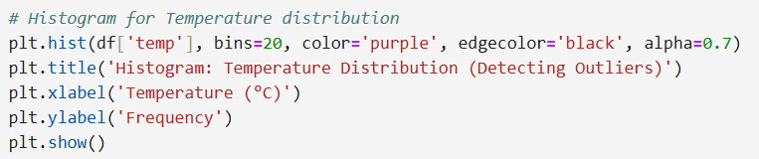
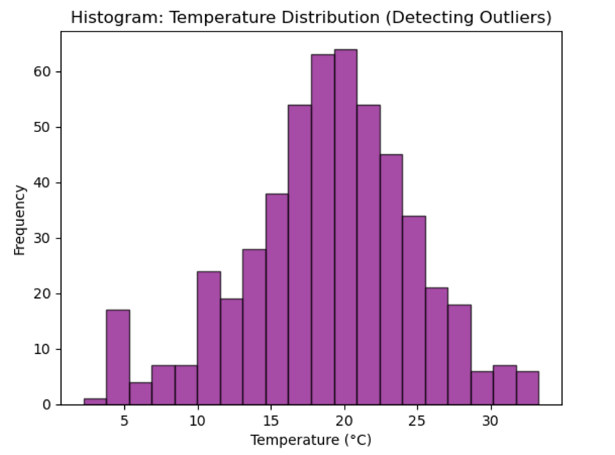
Histogram
The histogram is smooth and symmetrical, it suggests that there are fewer outliers, as extreme values would have affected the symmetry.

Slide 20
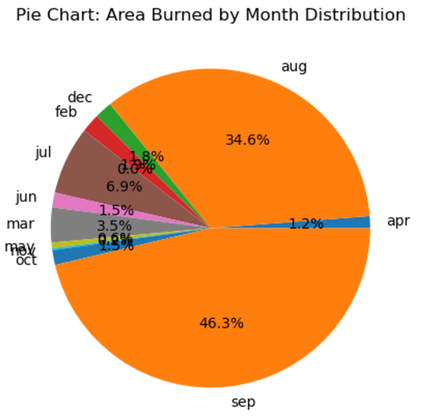
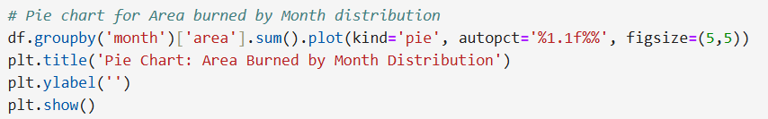
Pie Chart

Slide 21
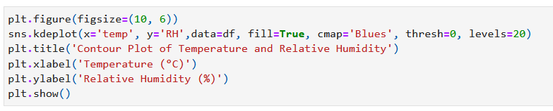
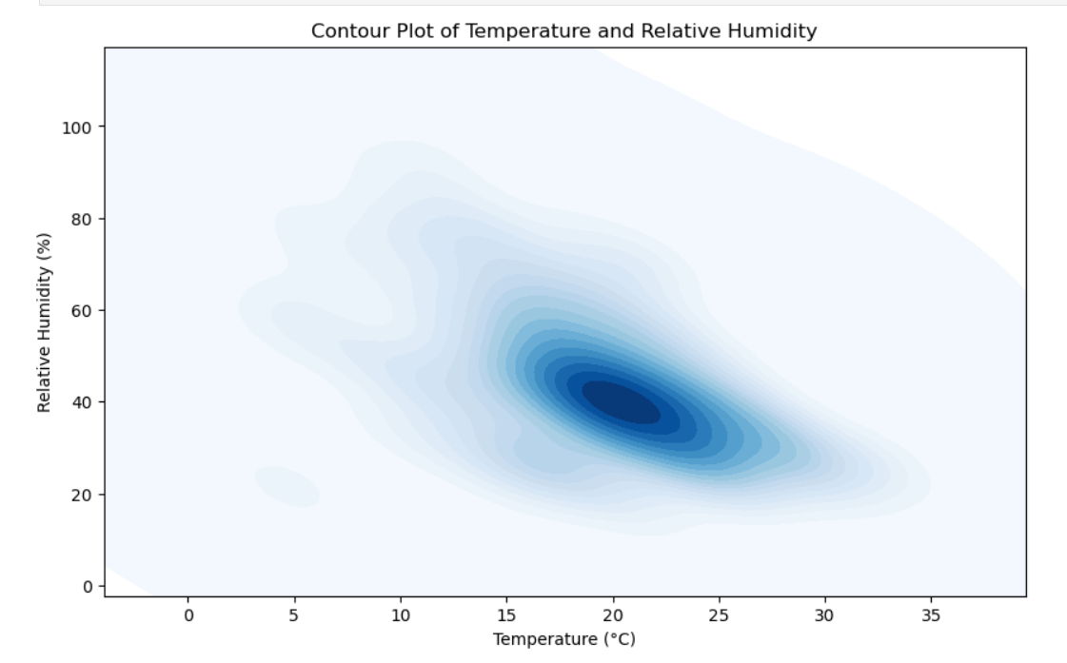
SEABORN Contourplot

Slide 22
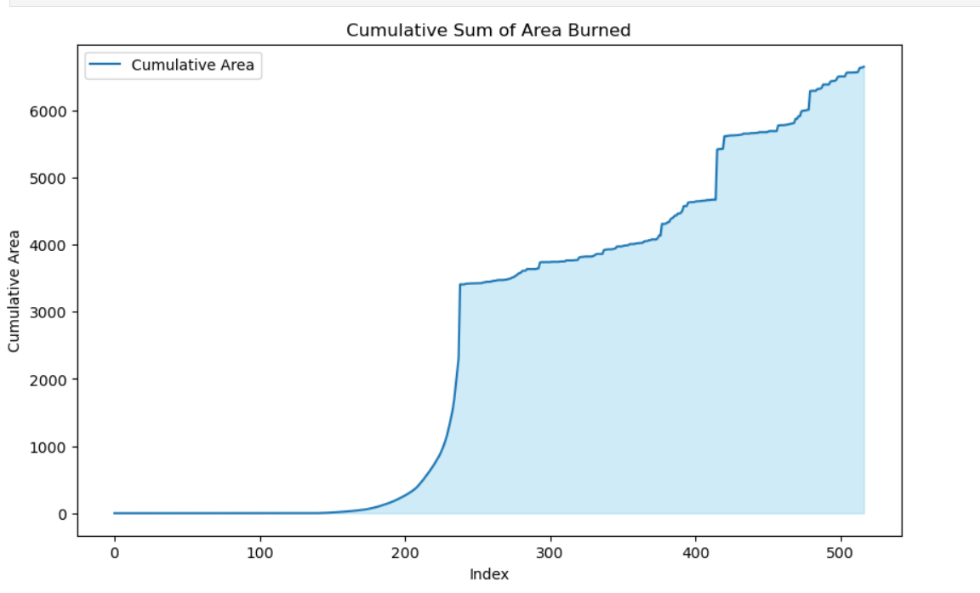
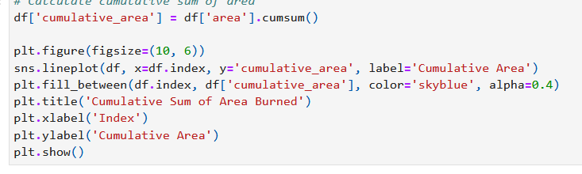
Lineplot

Slide 23
Autoviz
AutoViz is a Python library designed to simplify and automate the process of data visualization
generate insightful visualizations for your dataset with just a single line of code.
It's particularly useful for exploratory data analysis (EDA) as it abstracts
away the complexities of various plotting libraries and techniques

Slide 24

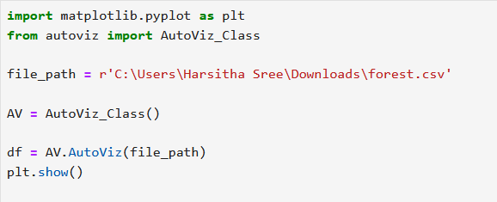
Autoviz

Slide 25
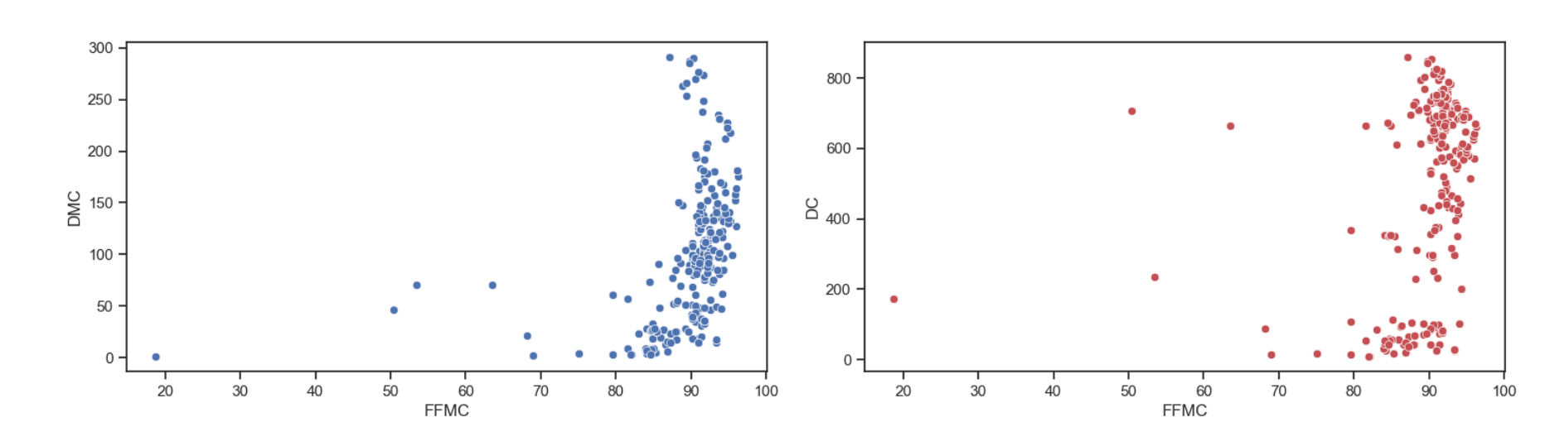
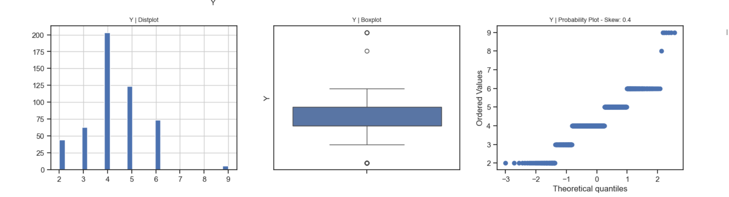

Slide 26
Module-4
Scikit learn
Data Cleaning
Imputation
Normalization

Slide 27
Scikit learn
Scikit-learn is a powerful open-source machine learning library in Python, designed to provide simple and efficient tools for data analysis and modeling.
It is primarily used for tasks such as classification, regression, clustering, dimensionality reduction, model selection, and data preprocessing.

Slide 28
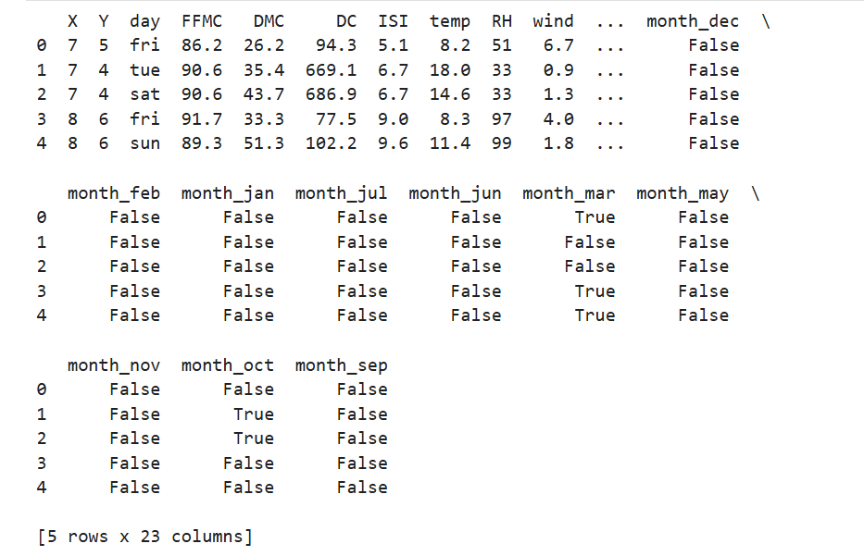
Scikit learn-Data cleaning
Create dummy varaiables
df_dummy=pd.get_dummies(df,column=[‘month’],drop_first=True)

Slide 29
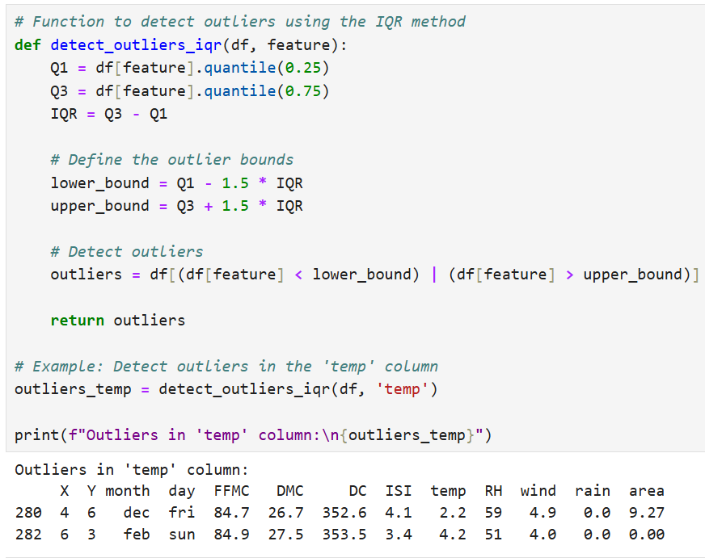
Detect Outliers
To detect outliers using the IQR method

Slide 30
Imputation
Imputation is the process of replacing missing or incomplete data with substituted values.
The goal is to fill in missing data points in a dataset to prevent incomplete information from hindering analysis or machine learning model performance.
Proper imputation helps to maintain the integrity of the dataset while preserving patterns and relationships between variables.

Slide 31
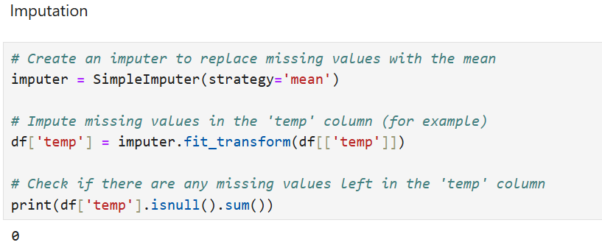
Treating missing values with imputation

Slide 32
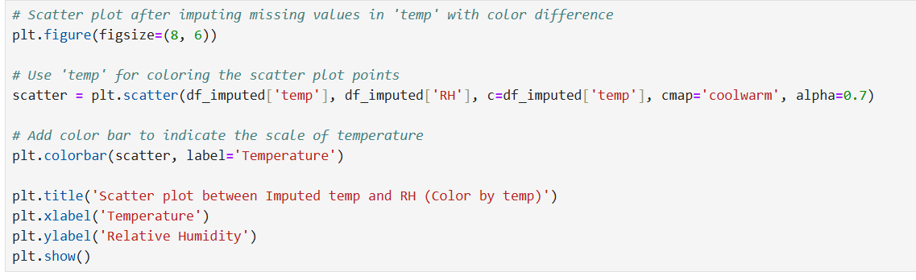
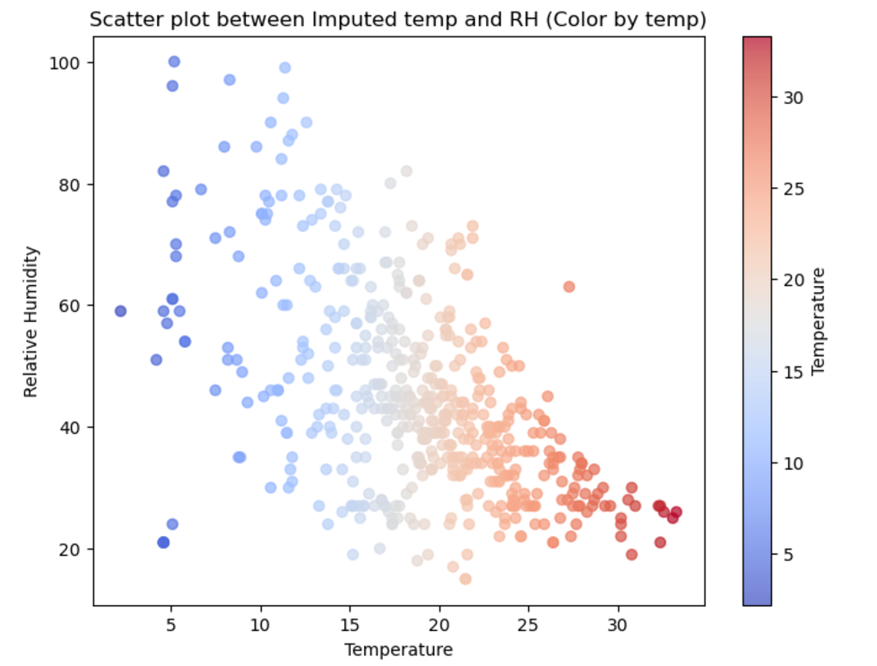
Imputation in Scatter plot

Slide 33
Data Normalization
Normalization is the process of scaling or transforming data into a specific range, typically [0, 1] or [-1, 1], to ensure that all features contribute equally to the analysis or machine learning model.
The main goal is to prevent features with larger ranges from dominating those with smaller ranges.

Slide 34
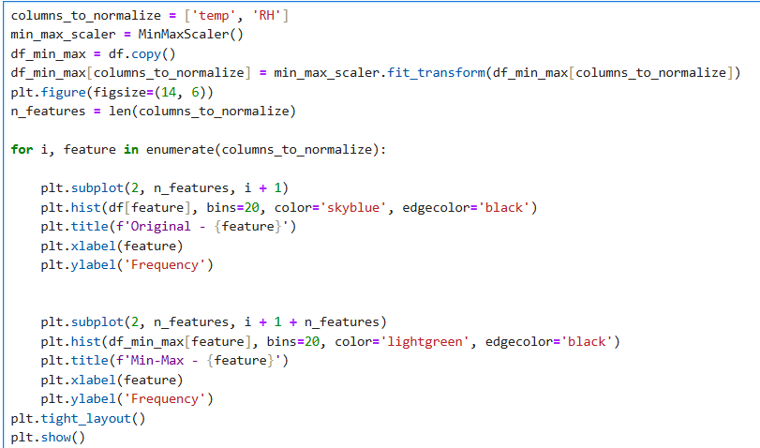
Plot histograms of the features before and after normalization

Slide 35
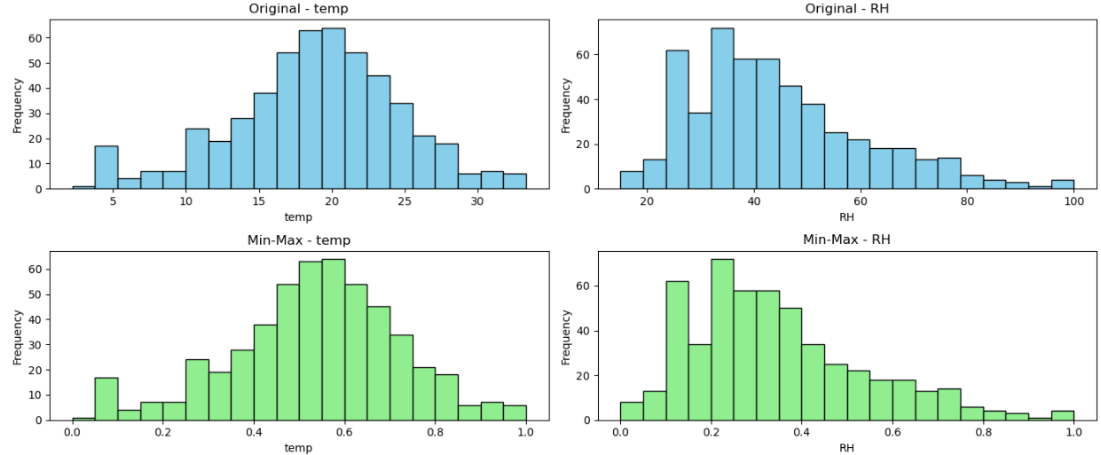
Histogram

Slide 36
Module-5
Advanced Visualization:
Geospatial Data Analysis and visualization
Temporal Data Visualisation

Slide 37
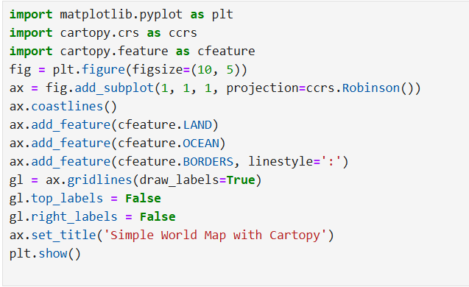
Geospatial Data Analysis and Visualization
Simple World Map

Slide 38
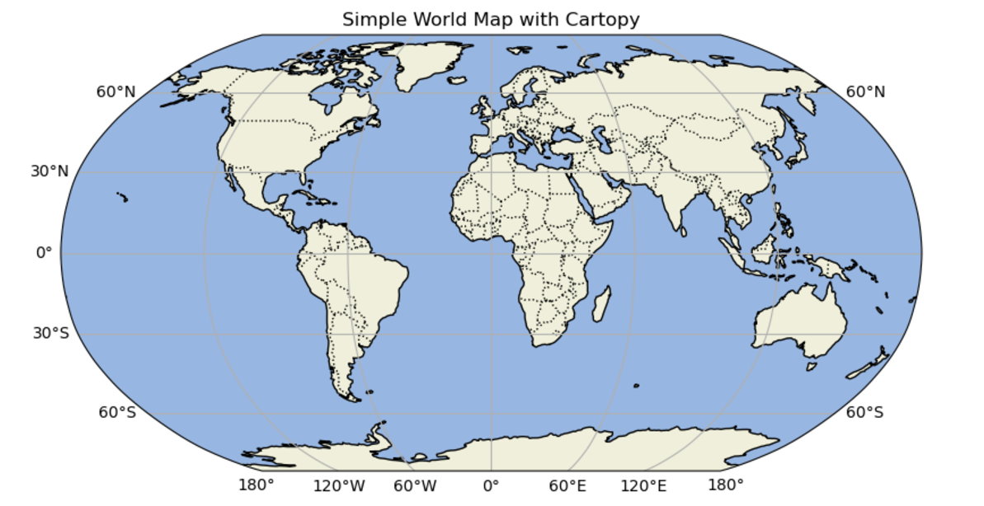
Output :

Slide 39
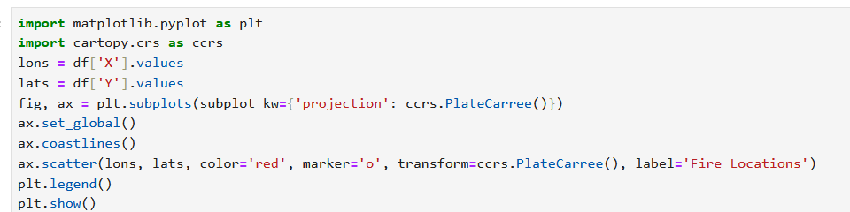
Geographic Distribution of Forest Fires: Visual Representation of Fire Locations

Slide 40
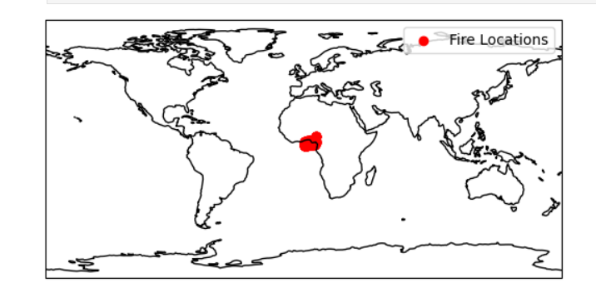
Output :

Slide 41
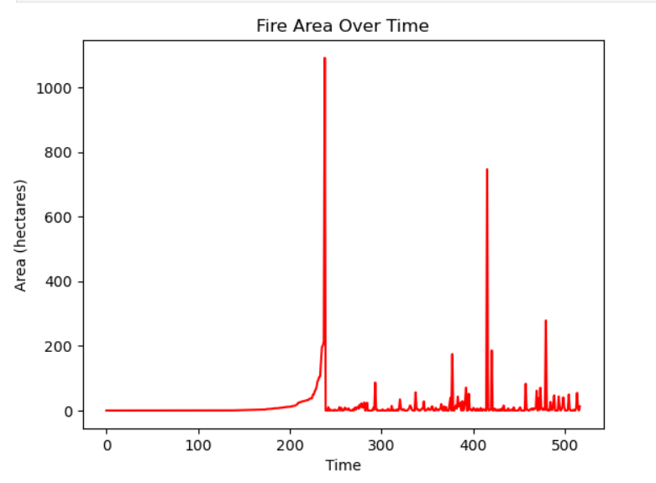
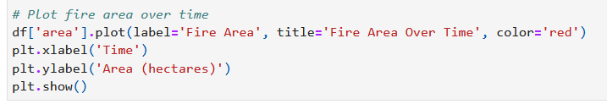
Temporal Data Visualization Time Series Data Plot fire area over time :

Slide 42
Module-6
Data Transformation and wrangling:
Data transforming using python
Data Wrangling using python

Slide 43

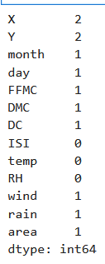

Data Transformation using Python
i) Detect and Count Missing Values in the Dataset
ii) Impute Missing Values with fillna() Function

Slide 44
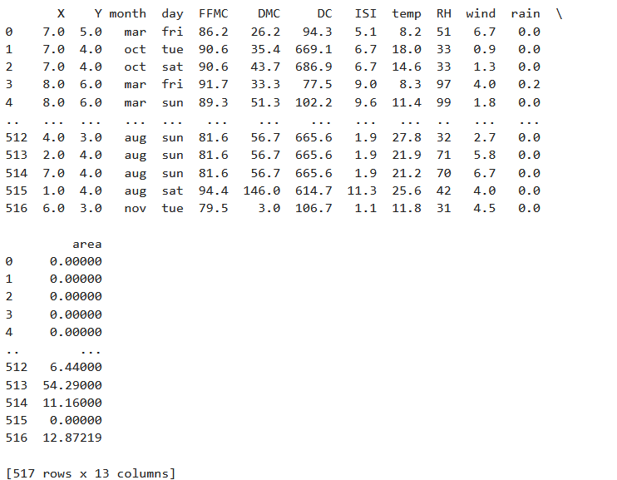
Filling the missing values with the mean of that column

Slide 45
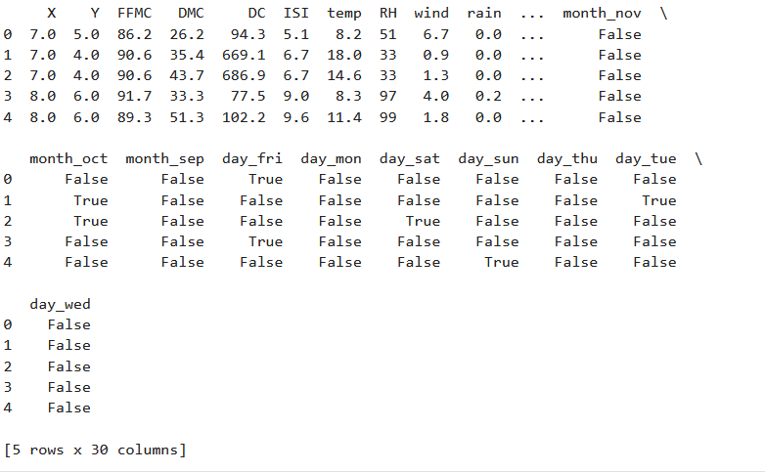
iii) Use Dummy Variables for Your Dataset

Slide 46
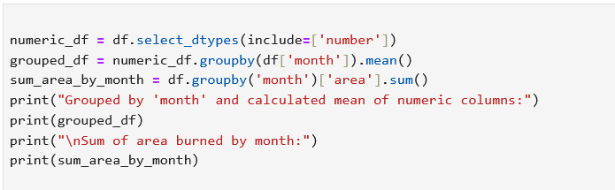
Data Wrangling I ) Use Groupby() to Apply Aggregation Functions

Slide 47
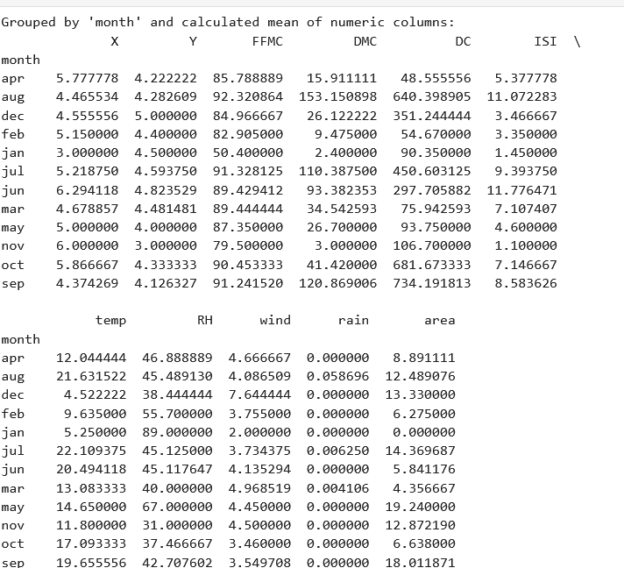
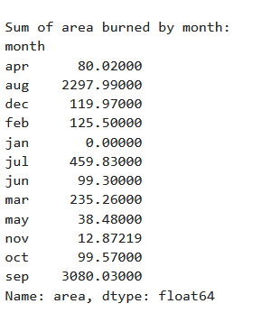
Group by month calculating the mean and sum of area burned

Slide 48
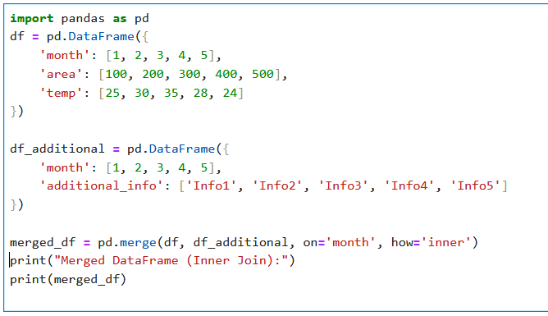
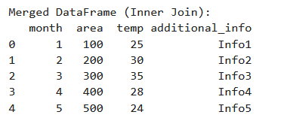
II ) Apply Merge Function to Concatenate Datasets

Slide 49
Module-7
Visualization with R and Power BI:
Visualizing data with R
Building interactive Dashboards with power BI

Slide 50
R programming
R programming is a language and environment primarily used for statistical computing, data analysis, and graphical representation.
Its primary purpose is to help users manipulate, analyze, and visualize data, especially in fields like statistics, machine learning, bioinformatics, and social sciences.
R is widely used in academia, research, and industry for data-driven decision-making.

Slide 51
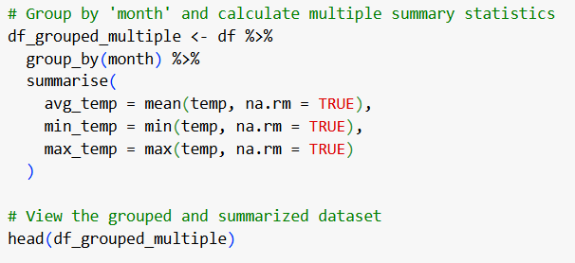
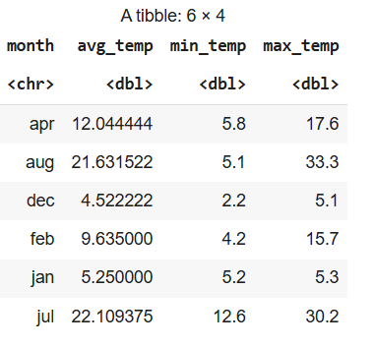
Using dplyr

Slide 52
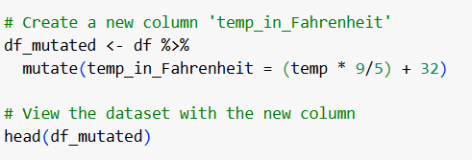
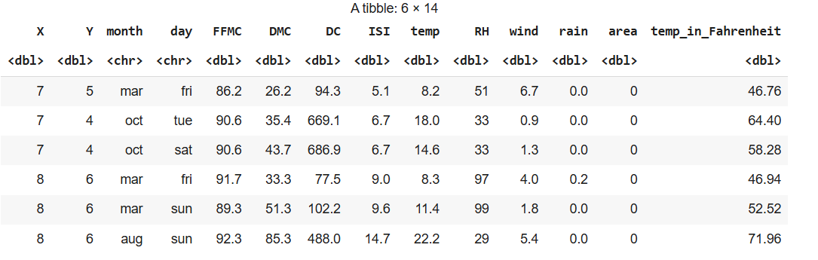
Mutate()

Slide 53
Group_by()

Slide 54
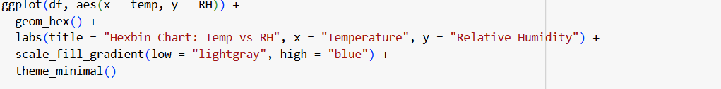
Hexbin

Slide 55
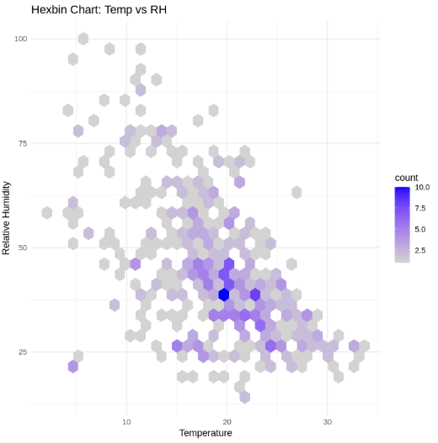
Hexbin

Slide 56
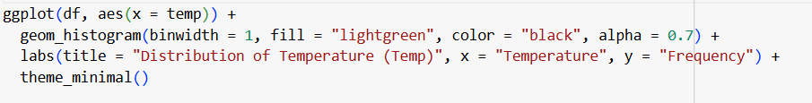
Histogram

Slide 57
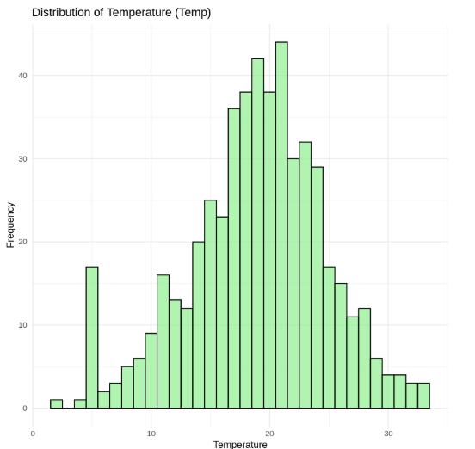
Histogram

Slide 58
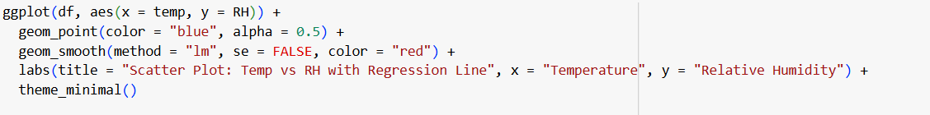
Scatter plot

Slide 59
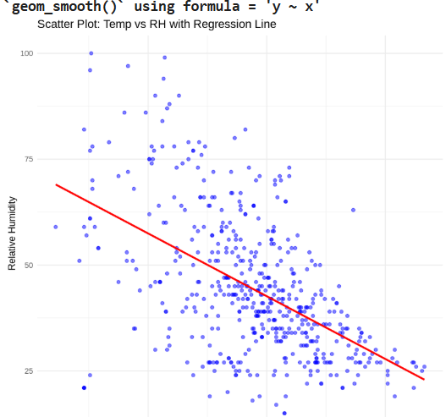
Scatter plot

Slide 60
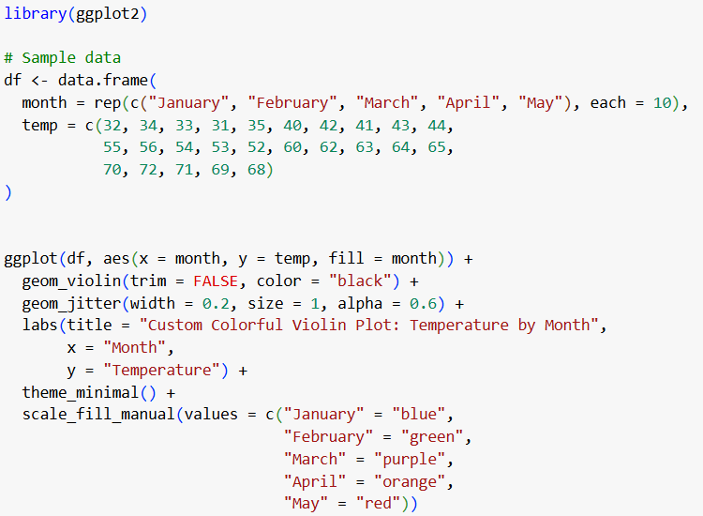
Violin plot

Slide 61

Violin plot

Slide 62
Power BI
Power BI is a business analytics tool developed by Microsoft, primarily used for data visualization, reporting, and business intelligence (BI).
Its purpose is to help individuals and organizations transform raw data into meaningful insights, enabling them to make informed, data-driven decisions.

Slide 63


Clustered Column chart

Slide 64


Pie chart

Slide 65

Donut Chart

Slide 66


Funnel Chart
With out tool tip
With tool tip

Slide 67

Table chart

Slide 68
conclusion
Forest Fire dataset covering various meteorological and environmental factors, reveals that higher temperatures, lower relative humidity, and increased wind speeds are strongly correlated with more frequent and extensive forest fires. Rainfall acts inversely, reducing fire occurrences and intensity. Seasonal trends indicate heightened fire activity during dry months like August and September. This comprehensive analysis ultimately protecting natural resources and communities.

Slide 69
THANK YOU

